Slide 1
Deep Learning-Based Sensor Fusion for 3D Object Detection in Autonomous Vehicles
Supervised By: Dr. Catherine Malak Noshy Ibrahim Elias
Presented By: Abdelrahman Zidan

Slide 2
Outline
Literature Review
Problem Formulation
Objectives
Contribution
What’s Next?

Slide 3
Literature Review
Research Gap:
Hazardous Weather Conditions
Small Objects
3D vs 2D interaction

Slide 4
Literature Review
Datasets

Slide 5
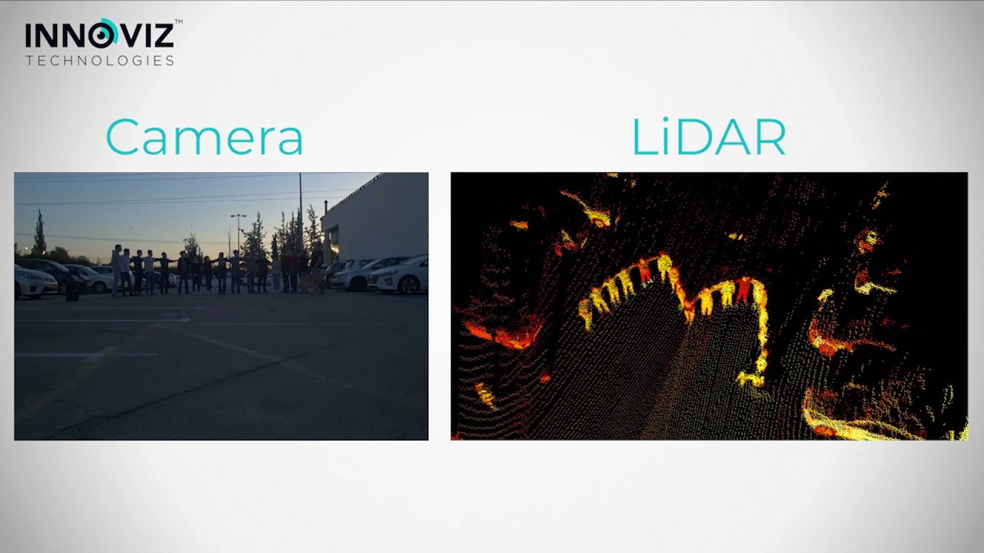
Problem Formulation
Sparse point clouds in LiDAR affect 3D object detection
Limited exploration of 3D sparse points & dense 2D pixel interaction
Most research only examines sensor fusion between two sensors, not three
https://www.youtube.com/watch?v=fjo00OLBzX0

Slide 6
Objectives
Explore sensor fusion between LiDARs, RADARs, and Cameras
Identify and apply Deep Learning models for:
Sensor Fusion
3D Object Detection
Optimize models using existing datasets like nuScenes and KITTI

Slide 7
Contribution
new multi-sensor fusion model
Compare with existing benchmarks for 3D object detection
Enhance sensor feature alignment and model optimization for better accuracy.

Slide 8
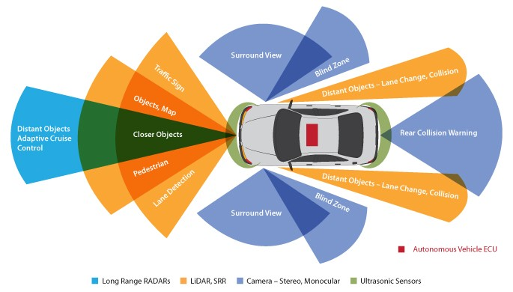
What’s Next?
Explore Deep Learning Fundamentals
Study the Most Suitable Models
Deep Dive into all 3 Sensors (LiDAR, Radar, Camera)
https://www.linkedin.com/pulse/sensor-fusion-essential-piece-autonomy-nakul-maan

Slide 9
Thank You

